Slide 1



Patterns & Frameworks for Synchronous Event Handling, Connections, & Service Initialization: Part 1
Douglas C. Schmidt
d.schmidt@vanderbilt.edu
www.dre.vanderbilt.edu/~schmidt
Professor of Computer Science
Institute for Software Integrated Systems Vanderbilt University Nashville, Tennessee, USA

Slide 2
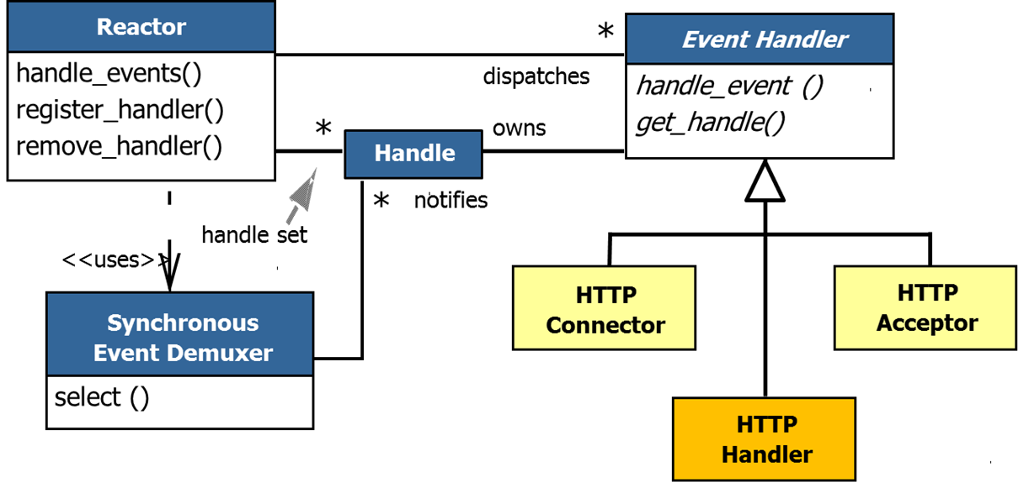
Topics Covered in this Part of the Module
Describe the Reactor & Acceptor-Connector patterns

Slide 3
Simplifying Event Handling Concerns
Context | Problem
Web servers must demux & process multiple types of indication events arriving from clients simultaneously | Developers often tightly couple event demuxing & connection code with app protocol processing code, which impedes understanding, reuse, & optimization
Use of non-portable handle type
Hard-coded to a particular system call
select (width, &ready_handles, 0, 0, 0);
if (FD_ISSET (acceptor, &ready_handles)) {
int h = accept (acceptor, 0, 0);
FD_SET (handle, &ready_handles);
// ... Handle connection acceptance
} else
for (int handle = s_handle + 1; handle < maxhandlep1; ++handle)
if (FD_ISSET (handle, &ready_handles)) {
// ... Perform HTTP processing
}
Inefficient O(n) sequential search
Tightly-coupled solution

Slide 4
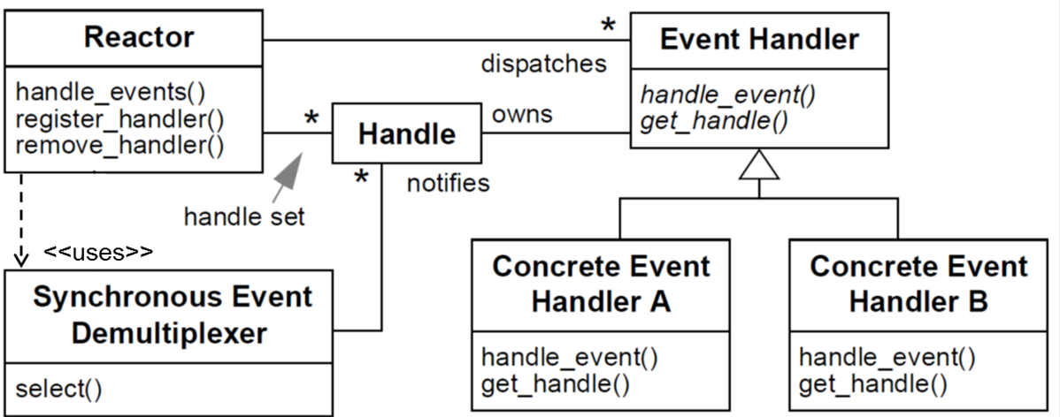
Simplifying Event Handling Concerns
Context | Problem | Solution
Web servers must demux & process multiple types of indication events arriving from clients simultaneously | Developers often tightly couple event demuxing & connection code with app protocol processing code, which impedes understanding, reuse, & optimization | Apply Reactor pattern & Acceptor-Connector pattern to separate the generic event demuxing & connection code from the JAWS protocol code
Structure
Reactor structures event-driven software to cleanly demux & dispatch service requests received from one or more clients

Slide 5
Simplifying Event Handling Concerns
Context | Problem | Solution
Web servers must demux & process multiple types of indication events arriving from clients simultaneously | Developers often tightly couple event demuxing & connection code with app protocol processing code, which impedes understanding, reuse, & optimization | Apply Reactor pattern & Acceptor-Connector pattern to separate the generic event demuxing & connection code from the JAWS protocol code
Structure
Reactor structures event-driven software to cleanly demux & dispatch service requests received from one or more clients

Slide 6
Simplifying Event Handling Concerns
Context | Problem | Solution
Web servers must demux & process multiple types of indication events arriving from clients simultaneously | Developers often tightly couple event demuxing & connection code with app protocol processing code, which impedes understanding, reuse, & optimization | Apply Reactor pattern & Acceptor-Connector pattern to separate the generic event demuxing & connection code from the JAWS protocol code
Structure
Reactor structures event-driven software to cleanly demux & dispatch service requests received from one or more clients
See www.dre.vanderbilt.edu/~schmidt/PDF/Reactor.pdf for more info

Slide 7
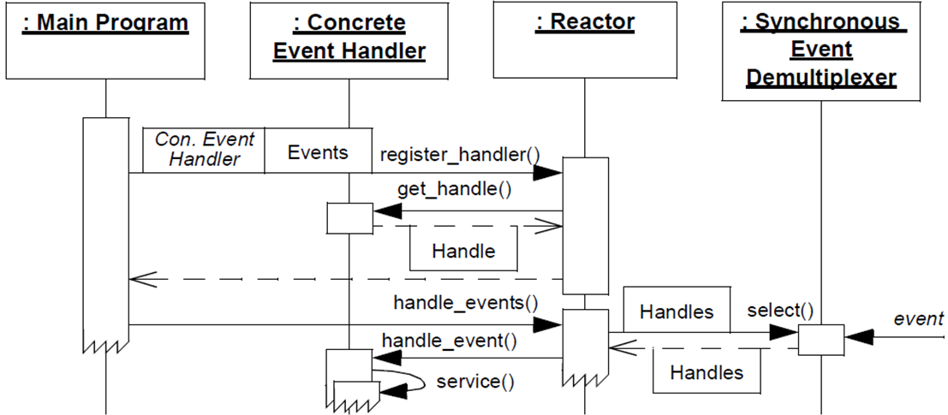
Simplifying Event Handling Concerns
Context | Problem | Solution
Web servers must demux & process multiple types of indication events arriving from clients simultaneously | Developers often tightly couple event demuxing & connection code with app protocol processing code, which impedes understanding, reuse, & optimization | Apply Reactor pattern & Acceptor-Connector pattern to separate the generic event demuxing & connection code from the JAWS protocol code
Dynamics
Registration phase
Event processing phase

Slide 8
Simplifying Event Handling Concerns
Context | Problem | Solution
Web servers must demux & process multiple types of indication events arriving from clients simultaneously | Developers often tightly couple event demuxing & connection code with app protocol processing code, which impedes understanding, reuse, & optimization | Apply Reactor pattern & Acceptor-Connector pattern to separate the generic event demuxing & connection code from the JAWS protocol code
Dynamics
Note inversion of control

Slide 9
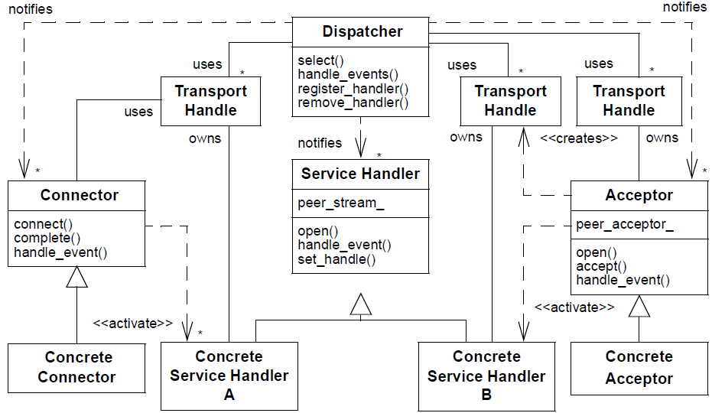
Simplifying Event Handling Concerns
Context | Problem | Solution
Web servers must demux & process multiple types of indication events arriving from clients simultaneously | Developers often tightly couple event demuxing & connection code with app protocol processing code, which impedes understanding, reuse, & optimization | Apply Reactor pattern & Acceptor-Connector pattern to separate the generic event demuxing & connection code from the JAWS protocol code
Structure
Reactor
Acceptor-Connector decouples the connection & initialization of peer services from the processing performed by the peer services after being connected & initialized

Slide 10
Simplifying Event Handling Concerns
Context | Problem | Solution
Web servers must demux & process multiple types of indication events arriving from clients simultaneously | Developers often tightly couple event demuxing & connection code with app protocol processing code, which impedes understanding, reuse, & optimization | Apply Reactor pattern & Acceptor-Connector pattern to separate the generic event demuxing & connection code from the JAWS protocol code
Structure
Reactor
Acceptor-Connector decouples the connection & initialization of peer services from the processing performed by the peer services after being connected & initialized

Slide 11
Simplifying Event Handling Concerns
Context | Problem | Solution
Web servers must demux & process multiple types of indication events arriving from clients simultaneously | Developers often tightly couple event demuxing & connection code with app protocol processing code, which impedes understanding, reuse, & optimization | Apply Reactor pattern & Acceptor-Connector pattern to separate the generic event demuxing & connection code from the JAWS protocol code
Structure
Reactor
Acceptor-Connector decouples the connection & initialization of peer services from the processing performed by the peer services after being connected & initialized

Slide 12
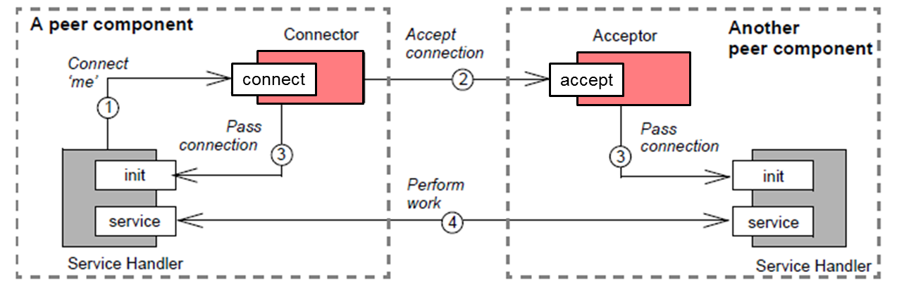
Simplifying Event Handling Concerns
Context | Problem | Solution
Web servers must demux & process multiple types of indication events arriving from clients simultaneously | Developers often tightly couple event demuxing & connection code with app protocol processing code, which impedes understanding, reuse, & optimization | Apply Reactor pattern & Acceptor-Connector pattern to separate the generic event demuxing & connection code from the JAWS protocol code
Dynamics
See www.dre.vanderbilt.edu/~schmidt/PDF/Acc-Con.pdf for more info

Slide 13
Applying the Reactor & Acceptor-Connector Patterns to JAWS
These patterns separate multiple concerns
Passive connection establishment & service initialization logic
Synchronous event demuxing & event handler dispatching logic
HTTP protocol processing performed in response to input events
JAWS doesn’t use Connector portion of the Acceptor-Connector pattern

Slide 14
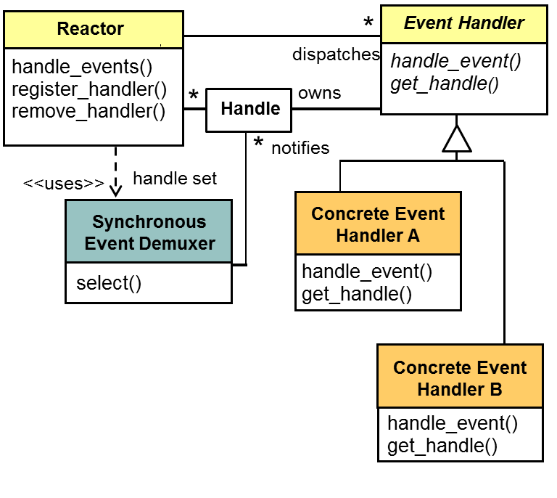
Benefits of the Reactor Pattern
Separation of concerns
Decouples generic demuxing & dispatching mechanisms from app-specific functionality

Slide 15
Benefits of the Reactor Pattern
Separation of concerns
Decouples generic demuxing & dispatching mechanisms from app-specific functionality
Modularity, reusability, & configurability
Separates event-driven app functionality into several loosely coupled components

Slide 16
Benefits of the Reactor Pattern
Separation of concerns
Decouples generic demuxing & dispatching mechanisms from app-specific functionality
Modularity, reusability, & configurability
Separates event-driven app functionality into several loosely coupled components
Portability
Can run on any platform that supports synchronous muxers

Slide 17
Benefits of the Reactor Pattern
Separation of concerns
Decouples generic demuxing & dispatching mechanisms from app-specific functionality
Modularity, reusability, & configurability
Separates event-driven app functionality into several loosely coupled components
Portability
Can run on any platform that supports synchronous muxers
Coarse-grained concurrency control
Serializes the invocation of event handlers at the level of event demuxing & dispatching within an application process

Slide 18
Limitations of the Reactor Pattern
Restricted applicability
Can be applied efficiently only if OS supports synchronous event demuxing

Slide 19
Limitations of the Reactor Pattern
Restricted applicability
Can be applied efficiently only if OS supports synchronous event demuxing
Non-pre-emptive & non-scalable
Event handlers borrow reactor thread & run to completion, preventing other event handler dispatching
Can’t leverage multi-CPUs/cores

Slide 20
Limitations of the Reactor Pattern
Restricted applicability
Can be applied efficiently only if OS supports synchronous event demuxing
Non-pre-emptive & non-scalable
Event handlers borrow reactor thread & run to completion, preventing other event handler dispatching
Can’t leverage multi-CPUs/cores
Complex debugging & testing
It is hard to debug apps structured using inversion of control, which oscillates between framework infrastructure & method call-backs on app-specific event handlers

Slide 21
Benefits of the Acceptor-Connector Pattern
Reusability, portability, & extensibility
Decouples mechanisms for connecting & initializing service handlers from the service processing performed after service handlers are connected & initialized
Event Handler
handle_event ()
get_handle()
HTTP
Connector
HTTP
Acceptor
HTTP
Handler

Slide 22
Benefits of the Acceptor-Connector Pattern
Reusability, portability, & extensibility
Decouples mechanisms for connecting & initializing service handlers from the service processing performed after service handlers are connected & initialized
Robustness
Strongly decouples the service handler from acceptor & connector, which ensures that a data-mode transport endpoint can’t accidentally be used to accept or connect
Event Handler
handle_event ()
get_handle()
HTTP
Connector
HTTP
Acceptor
HTTP
Handler

Slide 23
Benefits of the Acceptor-Connector Pattern
Reusability, portability, & extensibility
Decouples mechanisms for connecting & initializing service handlers from the service processing performed after service handlers are connected & initialized
Robustness
Strongly decouples the service handler from acceptor & connector, which ensures that a data-mode transport endpoint can’t accidentally be used to accept or connect
Efficiency
Can establish connections actively with many hosts asynchronously & efficiently over long-latency wide area networks
Event Handler
handle_event ()
get_handle()
HTTP
Connector
HTTP
Acceptor
HTTP
Handler

Slide 24
Limitations of the Acceptor-Connector Pattern
Additional indirection
Can incur additional indirection compared to using the underlying network programming interfaces directly
Event Handler
handle_event ()
get_handle()
HTTP
Connector
HTTP
Acceptor
HTTP
Handler

Slide 25
Limitations of the Acceptor-Connector Pattern
Additional indirection
Can incur additional indirection compared to using the underlying network programming interfaces directly
Additional complexity
May add unnecessary complexity for simple client applications that connect with only one server & perform one service using a single network programming interface
Event Handler
handle_event ()
get_handle()
HTTP
Connector
HTTP
Acceptor
HTTP
Handler

Slide 26
Patterns & Frameworks for Synchronous Event Handling, Connections, & Service Initialization: Part 2
Douglas C. Schmidt
d.schmidt@vanderbilt.edu
www.dre.vanderbilt.edu/~schmidt
Professor of Computer Science
Institute for Software Integrated Systems Vanderbilt University Nashville, Tennessee, USA

Slide 27
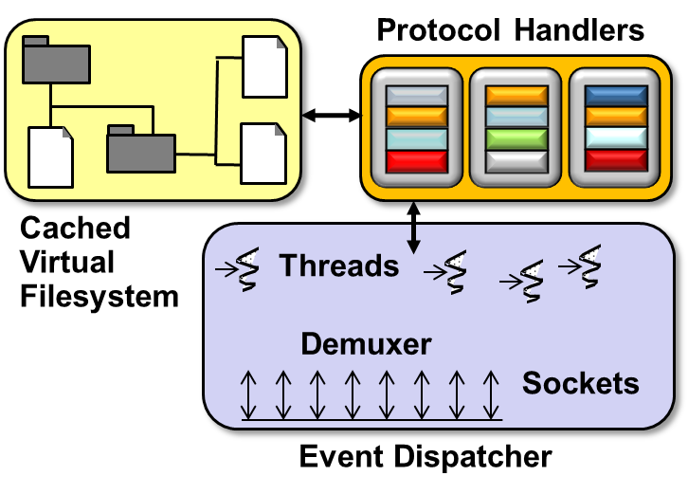
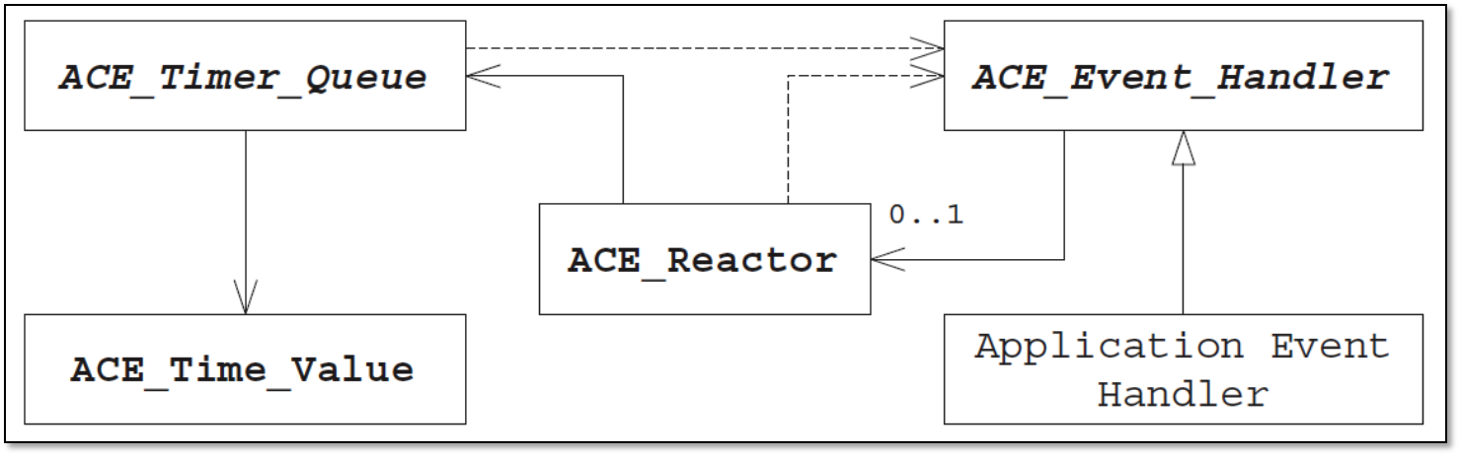
Topics Covered in this Part of the Module
Describe the Reactor & Acceptor-Connector patterns
Describe the ACE Reactor framework

Slide 28
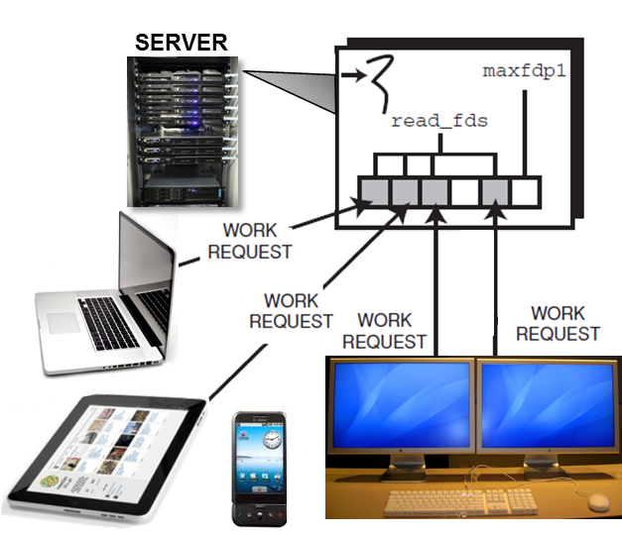
Motivation for the ACE Reactor Framework
Event-driven networked app have historically been programmed via native OS mechanisms
e.g., Socket API & select()
select (maxfdp1, &ready_handles, 0, 0, 0);
if (FD_ISSET (acceptor, &ready_handles)) {
int h = accept (acceptor, 0, 0);
FD_SET (handle, &ready_handles);
// ... Handle connection acceptance
} else
for (int handle = s_handle + 1; handle < maxhandlep1; ++handle)
if (FD_ISSET (handle, &ready_handles)) {
// ... Perform app protocol processing
}

Slide 29
Motivation for the ACE Reactor Framework
Event-driven networked app have historically been programmed via native OS mechanisms
e.g., Socket API & select()
Apps developed this way are often non-portable & inflexible
i.e., they tightly couple event detection, demuxing, & dispatching code together with app event processing code
select (maxfdp1, &ready_handles, 0, 0, 0);
if (FD_ISSET (acceptor, &ready_handles)) {
int h = accept (acceptor, 0, 0);
FD_SET (handle, &ready_handles);
// ... Handle connection acceptance
} else
for (int handle = s_handle + 1; handle < maxhandlep1; ++handle)
if (FD_ISSET (handle, &ready_handles)) {
// ... Perform app protocol processing
}

Slide 30
Motivation for the ACE Reactor Framework
Event-driven networked app have historically been programmed via native OS mechanisms
e.g., Socket API & select()
Apps developed this way are often non-portable & inflexible
i.e., they tightly couple event detection, demuxing, & dispatching code together with app event processing code
Developers therefore rewrite much code for each new app
Tedious, expensive, & error prone
select (maxfdp1, &ready_handles, 0, 0, 0);
if (FD_ISSET (acceptor, &ready_handles)) {
int h = accept (acceptor, 0, 0);
FD_SET (handle, &ready_handles);
// ... Handle connection acceptance
} else
for (int handle = s_handle + 1; handle < maxhandlep1; ++handle)
if (FD_ISSET (handle, &ready_handles)) {
// ... Perform app protocol processing
}

Slide 31
Motivation for the ACE Reactor Framework
Event-driven networked app have historically been programmed via native OS mechanisms
e.g., Socket API & select()
Apps developed this way are often non-portable & inflexible
i.e., they tightly couple event detection, demuxing, & dispatching code together with app event processing code
Developers therefore rewrite much code for each new app
Tedious, expensive, & error prone
Much event detection, demuxing, & dispatching logic can be generalized & reused across many apps
select (maxfdp1, &ready_handles, 0, 0, 0);
if (FD_ISSET (acceptor, &ready_handles)) {
int h = accept (acceptor, 0, 0);
FD_SET (handle, &ready_handles);
// ... Handle connection acceptance
} else
for (int handle = s_handle + 1; handle < maxhandlep1; ++handle)
if (FD_ISSET (handle, &ready_handles)) {
// ... Perform app protocol processing
}

Slide 32
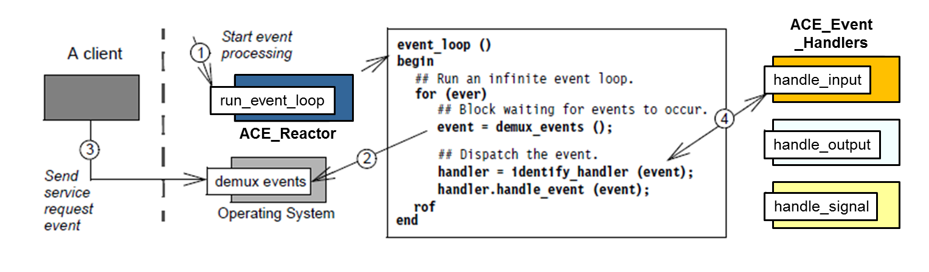
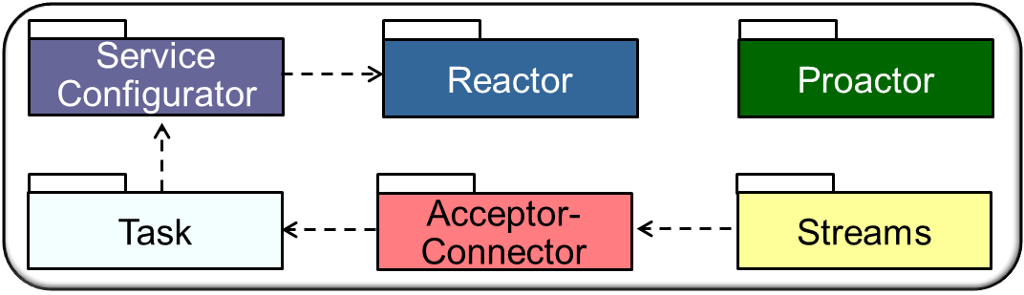
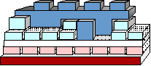
Overview of the ACE Reactor Framework
Classes in this framework allow event-driven apps to react to events from a range of event sources
e.g., I/O handles, timers, & signals

Slide 33
Overview of the ACE Reactor Framework
Classes in this framework allow event-driven apps to react to events from a range of event sources
Apps inherit from ACE_Event_Handler & override its hook methods, which the ACE Reactor framework then dispatches to process events
These classes are designed in accordance with the Reactor pattern

Slide 34
Overview of the ACE Reactor Framework
Classes in this framework allow event-driven apps to react to events from a range of event sources (e.g., I/O handles, timers, & signals)
Apps inherit from ACE_Event_Handler & override its hook methods, which the ACE Reactor framework then dispatches to process events
Key classes in the ACE Reactor framework include
ACE Class | Description
ACE_Time_Value | Provides a portable, normalized representation of time & duration that uses C++ operator overloading to simplify time-related arithmetic & relational operations
ACE_Timer_Queue | An abstract class defining the capabilities & interface for a timer queue (ACE provides several subclasses that provide flexible support for various timing requirements)
ACE_Event_Handler | An abstract class whose interface defines the hook methods that are the targets of ACE_Reactor callbacks
ACE_Reactor | Provides the interface for managing event handler registrations & executing the event loop that drives event detection, demultiplexing, & dispatching in the ACE Reactor framework

Slide 35
Overview of the ACE Reactor Framework
Classes in this framework allow event-driven apps to react to events from a range of event sources (e.g., I/O handles, timers, & signals)
Apps inherit from ACE_Event_Handler & override its hook methods, which the ACE Reactor framework then dispatches to process events
Key classes in the ACE Reactor framework include
ACE Class | Description
ACE_Time_Value | Provides a portable, normalized representation of time & duration that uses C++ operator overloading to simplify time-related arithmetic & relational operations
ACE_Timer_Queue | An abstract class defining the capabilities & interface for a timer queue (ACE provides several subclasses that provide flexible support for various timing requirements)
ACE_Event_Handler | An abstract class whose interface defines the hook methods that are the targets of ACE_Reactor callbacks
ACE_Reactor | Provides the interface for managing event handler registrations & executing the event loop that drives event detection, demultiplexing, & dispatching in the ACE Reactor framework

Slide 36
Overview of the ACE Reactor Framework
Classes in this framework allow event-driven apps to react to events from a range of event sources (e.g., I/O handles, timers, & signals)
Apps inherit from ACE_Event_Handler & override its hook methods, which the ACE Reactor framework then dispatches to process events
Key classes in the ACE Reactor framework include
ACE Class | Description
ACE_Time_Value | Provides a portable, normalized representation of time & duration that uses C++ operator overloading to simplify time-related arithmetic & relational operations
ACE_Timer_Queue | An abstract class defining the capabilities & interface for a timer queue (ACE provides several subclasses that provide flexible support for various timing requirements)
ACE_Event_Handler | An abstract class whose interface defines the hook methods that are the targets of ACE_Reactor callbacks
ACE_Reactor | Provides the interface for managing event handler registrations & executing the event loop that drives event detection, demultiplexing, & dispatching in the ACE Reactor framework

Slide 37
Overview of the ACE Reactor Framework
Classes in this framework allow event-driven apps to react to events from a range of event sources (e.g., I/O handles, timers, & signals)
Apps inherit from ACE_Event_Handler & override its hook methods, which the ACE Reactor framework then dispatches to process events
Key classes in the ACE Reactor framework include
ACE Class | Description
ACE_Time_Value | Provides a portable, normalized representation of time & duration that uses C++ operator overloading to simplify time-related arithmetic & relational operations
ACE_Timer_Queue | An abstract class defining the capabilities & interface for a timer queue (ACE provides several subclasses that provide flexible support for various timing requirements)
ACE_Event_Handler | An abstract class whose interface defines the hook methods that are the targets of ACE_Reactor callbacks
ACE_Reactor | Provides the interface for managing event handler registrations & executing the event loop that drives event detection, demultiplexing, & dispatching in the ACE Reactor framework
See www.dre.vanderbilt.edu/~schmidt/PDF/reactor-rules.pdf for more info

Slide 38
Motivation for Object-Oriented Event Handling
Networked apps are often event driven & their processing is driven by callbacks to event handlers
Implementing callbacks by defining a separate function handlers for each type of event lacks cohesion & is error-prone
function₁
data₁
function₂
data₂
function₃
data₃
Demultiplexer
Event Sources

Slide 39
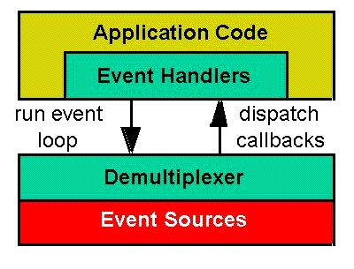
Motivation for Object-Oriented Event Handling
Networked apps are often event driven & their processing is driven by callbacks to event handlers
Implementing callbacks by defining a separate function handlers for each type of event lacks cohesion & is error-prone
function₁
data₁
function₂
data₂
function₃
data₃
Demultiplexer
Event Sources
Application Code
It is more effective to devise a more cohesive object-oriented event demuxing mechanism
e.g., implement callbacks via event handler objects that integrate data & methods
Event Handlers
Demultiplexer
Event Sources

Slide 40
The ACE_Event_Handler Class
Base class of all reactive event handlers provides the following capabilities:
Hook methods for input, output, exception, timer, & signal events
ACE_Event_Handler
reactor_ : ACE_Reactor *
handle_input()
handle_output()
handle_exception()
handle_timeout()
handle_signal()
handle_close()
get_handle()
reactor()
…

Slide 41
The ACE_Event_Handler Class
Base class of all reactive event handlers provides the following capabilities:
Hook methods for input, output, exception, timer, & signal events
It centralizes how event handlers are destroyed when they're not needed
ACE_Event_Handler
reactor_ : ACE_Reactor *
handle_input()
handle_output()
handle_exception()
handle_timeout()
handle_signal()
handle_close()
get_handle()
reactor()
…

Slide 42
The ACE_Event_Handler Class
Base class of all reactive event handlers provides the following capabilities:
Hook methods for input, output, exception, timer, & signal events
It centralizes how event handlers are destroyed when they're not needed
It holds a pointer to an instance of the ACE_Reactor that manages it
Allows an event handler to manage its event (de)registration
ACE_Event_Handler
reactor_ : ACE_Reactor *
handle_input()
handle_output()
handle_exception()
handle_timeout()
handle_signal()
handle_close()
get_handle()
reactor()
…

Slide 43
The ACE_Event_Handler Class
Base class of all reactive event handlers provides the following capabilities:
Hook methods for input, output, exception, timer, & signal events
It centralizes how event handlers are destroyed when they're not needed
It holds a pointer to an instance of the ACE_Reactor that manages it
Allows an event handler to manage its event (de)registration
OO callbacks simplify association of data with hook methods that manipulate data
ACE_Event_Handler
HTTP_Event_Handler
stream_ : ACE_SOCK_Stream
handle_input()
get_handle()
…
Handles variability of event processing via a common event handler API

Slide 44
Types of Events & Event Handler Hooks
When an app registers an event handler with a reactor, it must indicate what type(s) of event(s) the event handler should process
int HTTP_Event_Handler::open ()
{
return reactor ()->register_handler
(this, ACE_Event_Handler::READ_MASK);
}
Register with the reactor to receive input events containing GET requests

Slide 45
Types of Events & Event Handler Hooks
When an app registers an event handler with a reactor, it must indicate what type(s) of event(s) the event handler should process
ACE designates these event types via enumerators defined in ACE_Event _Handler that are associated with handle_*() hook methods
Event Type | Description
READ_MASK | Indicates input events, such as data on a socket or file handle – a reactor dispatches handle input() to process input events
WRITE_MASK | Indicates output events, such as when flow control abates – a reactor dispatches the handle output() to process output events
EXCEPT_MASK | Indicates exceptional events, such as urgent data on a socket – a reactor dispatches handle exception() to process exceptional events
ACCEPT_MASK | Indicates passive-mode connection events – a reactor dispatches the handle input() to process connection events
CONNECT_MASK | Indicates a non-blocking connection completion – a reactor dispatches handle output() to process non-blocking connection completion events

Slide 46
Types of Events & Event Handler Hooks
When an app registers an event handler with a reactor, it must indicate what type(s) of event(s) the event handler should process
ACE designates these event types via enumerators defined in ACE_Event _Handler that are associated with handle_*() hook methods
Event Type | Description
READ_MASK | Indicates input events, such as data on a socket or file handle – a reactor dispatches handle input() to process input events
WRITE_MASK | Indicates output events, such as when flow control abates – a reactor dispatches the handle output() to process output events
EXCEPT_MASK | Indicates exceptional events, such as urgent data on a socket – a reactor dispatches handle exception() to process exceptional events
ACCEPT_MASK | Indicates passive-mode connection events – a reactor dispatches the handle input() to process connection events
CONNECT_MASK | Indicates a nonblocking connection completion – a reactor dispatches handle output() to process nonblocking connection completion events
These values can be combined (“or’d” together) to designate a set of events
These events can populate the ACE_Reactor_Mask parameter passed to ACE_Reactor::register_handler()

Slide 47
Event Handler Hook Method Return Values
When registered events occur, the reactor dispatches the appropriate event handler's handle_*() hook methods to process them
Called back by the reactor when a data event occurs
int HTTP_Event_Handler::handle_input (ACE_HANDLE) {
std::string pathname (get_pathname (stream_));
ACE_Mem_Map mapped_file (pathname.c_str ());
peer ().send_n (mapped_file.addr (),
mapped_file.size ());
...
}

Slide 48
Event Handler Hook Method Return Values
When registered events occur, the reactor dispatches the appropriate event handler's handle_*() hook methods to process them
When a handle_*() method finishes its processing, it must return a value that's interpreted by the reactor as follows:
Returns | Behavior
Zero (0) | Indicates reactor should continue to detect & dispatch registered events for this handler/handle
Minus one (−1) | Instructs the reactor to stop detecting registered event for this handler/handle & call its handle_close() hook method
Greater than zero (> 0) | Indicates that the reactor should continue to detect & dispatch the registered event for this handler/handle

Slide 49
Event Handler Hook Method Return Values
When registered events occur, the reactor dispatches the appropriate event handler's handle_*() hook methods to process them
When a handle_*() method finishes its processing, it must return a value that's interpreted by the reactor as follows:
Before the reactor removes an event handler, it invokes the handler's hook method handle_close(), passing ACE_Reactor_Mask of the event that's being unregistered
Returns | Behavior
Zero (0) | Indicates reactor should continue to detect & dispatch registered events for this handler/handle
Minus one (−1) | Instructs the reactor to stop detecting registered event for this handler/handle & call its handle_close() hook method
Greater than zero (> 0) | Indicates that the reactor should continue to detect & dispatch the registered event for this handler/handle

Slide 50
The ACE_Reactor Class
Defines an interface for ACE Reactor framework capabilities:
Centralizes event loop processing
ACE_Event _Handler
ACE_Reactor
*
run_event_loop()
register_handler()
remove_handler()
dispatches
handle_input ()
handle_timeout ()
…
get_handle()
*
owns
Handle
*
notifies
<<uses>>
handle set
Synchronous
Event Demuxer
Concrete Event Handler A
select()
handle_input()
get_handle()
Concrete Event Handler B
handle_timeout()
get_handle()

Slide 51
The ACE_Reactor Class
Defines an interface for ACE Reactor framework capabilities:
Centralizes event loop processing
Detects events via an OS event muxer
ACE_Event _Handler
ACE_Reactor
*
run_event_loop()
register_handler()
remove_handler()
dispatches
handle_input ()
handle_timeout ()
…
get_handle()
*
owns
Handle
*
notifies
<<uses>>
handle set
Synchronous
Event Demuxer
Concrete Event Handler A
select()
handle_input()
get_handle()
Concrete Event Handler B
handle_timeout()
get_handle()

Slide 52
The ACE_Reactor Class
Defines an interface for ACE Reactor framework capabilities:
Centralizes event loop processing
Detects events via an OS event muxer
Demuxes events to registered event handlers when event muxer detects occurrence of events
ACE_Event _Handler
ACE_Reactor
*
run_event_loop()
register_handler()
remove_handler()
dispatches
handle_input ()
handle_timeout ()
…
get_handle()
*
owns
Handle
*
notifies
<<uses>>
handle set
Synchronous
Event Demuxer
Concrete Event Handler A
select()
handle_input()
get_handle()
Concrete Event Handler B
handle_timeout()
get_handle()

Slide 53
The ACE_Reactor Class
Defines an interface for ACE Reactor framework capabilities:
Centralizes event loop processing
Detects events via an OS event muxer
Demuxes events to registered event handlers when event muxer detects occurrence of events
Dispatches hook method(s) on event handler(s) to perform app-defined processing in response to events
ACE_Event _Handler
ACE_Reactor
*
run_event_loop()
register_handler()
remove_handler()
dispatches
handle_input ()
handle_timeout ()
…
get_handle()
*
owns
Handle
*
notifies
<<uses>>
handle set
Synchronous
Event Demuxer
Concrete Event Handler A
select()
handle_input()
get_handle()
Concrete Event Handler B
handle_timeout()
get_handle()
Handles variability of synchronous event (de)muxing via a common API

Slide 54
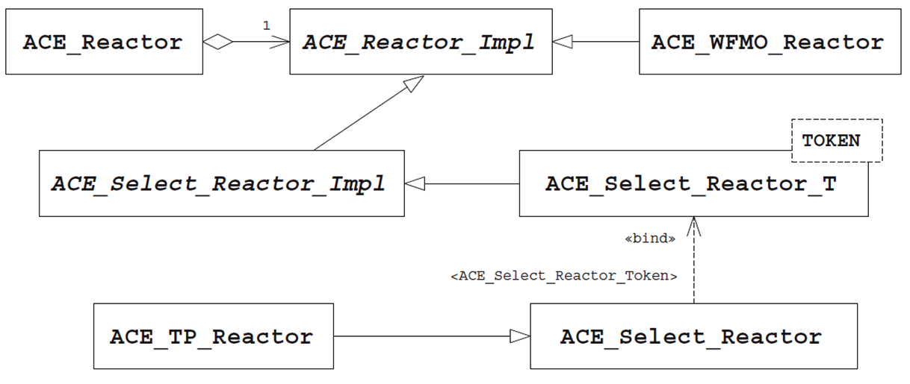
ACE Reactor Implementations
The ACE Reactor framework was designed for extensibility
Internally it uses the Bridge pattern & there are nearly a dozen reactor implementations in ACE

Slide 55
ACE Reactor Implementations
The ACE Reactor framework was designed for extensibility
Internally it uses the Bridge pattern & there are nearly a dozen reactor implementations in ACE
The most common Reactor implementations include:
ACE Class | Description
ACE_Select_Reactor | Uses the select() event muxer function to detect I/O & timer events; incorporates orderly handling of POSIX signals
ACE_TP_Reactor | Uses the Leader/Followers pattern to extend ACE_Select_Reactor event handling to a pool of threads
ACE_WFMO_Reactor | Uses the Windows WaitForMultipleObjects() event muxer function to detect socket I/O, timeouts, & Windows events
ACE_Dev_Poll_Reactor | Uses the UNIX /dev/poll & /dev/epoll event muxer functions that are more scalable than select()

Slide 56
ACE Reactor Implementations
The ACE Reactor framework was designed for extensibility
Internally it uses the Bridge pattern & there are nearly a dozen reactor implementations in ACE
The most common Reactor implementations include:
ACE Class | Description
ACE_Select_Reactor | Uses the select() event muxer function to detect I/O & timer events; incorporates orderly handling of POSIX signals
ACE_TP_Reactor | Uses the Leader/Followers pattern to extend ACE_Select_Reactor event handling to a pool of threads
ACE_WFMO_Reactor | Uses the Windows WaitForMultipleObjects() event muxer function to detect socket I/O, timeouts, & Windows events
ACE_Dev_Poll_Reactor | Uses the UNIX /dev/poll & /dev/epoll event muxer functions that are more scalable than select()

Slide 57
ACE Reactor Implementations
The ACE Reactor framework was designed for extensibility
Internally it uses the Bridge pattern & there are nearly a dozen reactor implementations in ACE
The most common Reactor implementations include:
ACE Class | Description
ACE_Select_Reactor | Uses the select() event muxer function to detect I/O & timer events; incorporates orderly handling of POSIX signals
ACE_TP_Reactor | Uses the Leader/Followers pattern to extend ACE_Select_Reactor event handling to a pool of threads
ACE_WFMO_Reactor | Uses the Windows WaitForMultipleObjects() event muxer function to detect socket I/O, timeouts, & Windows events
ACE_Dev_Poll_Reactor | Uses the UNIX /dev/poll & /dev/epoll event muxer functions that are more scalable than select()

Slide 58
ACE Reactor Implementations
The ACE Reactor framework was designed for extensibility
Internally it uses the Bridge pattern & there are nearly a dozen reactor implementations in ACE
The most common Reactor implementations include:
ACE Class | Description
ACE_Select_Reactor | Uses the select() event muxer function to detect I/O & timer events; incorporates orderly handling of POSIX signals
ACE_TP_Reactor | Uses the Leader/Followers pattern to extend ACE_Select_Reactor event handling to a pool of threads
ACE_WFMO_Reactor | Uses the Windows WaitForMultipleObjects() event muxer function to detect socket I/O, timeouts, & Windows events
ACE_Dev_Poll_Reactor | Uses the Solaris /dev/poll & Linux /dev/epoll event muxer functions that are more scalable than select()

Slide 59
Summary
The ACE Reactor framework
Simplifies the development of concise, correct, portable, & efficient event-driven networked apps
Encapsulates OS event muxing mechanisms within an OO C++ interface
ACE_Event _Handler
ACE_Reactor
*
run_event_loop()
register_handler()
remove_handler()
dispatches
handle_input ()
handle_timeout ()
…
get_handle()
*
owns
Handle
*
notifies
<<uses>>
handle set
Synchronous
Event Demuxer
Concrete Event Handler A
select()
handle_input()
get_handle()
Concrete Event Handler B
handle_timeout()
get_handle()

Slide 60
Summary
The ACE Reactor framework
Simplifies the development of concise, correct, portable, & efficient event-driven networked apps
Encapsulates OS event muxing mechanisms within an OO C++ interface
Enhances reuse, improves portability, & enables the extensibility of event handlers
Separates generic event detection, demuxing, & dispatching mechanisms from app-defined event processing policies
ACE_Event _Handler
ACE_Reactor
*
run_event_loop()
register_handler()
remove_handler()
dispatches
handle_input ()
handle_timeout ()
…
get_handle()
*
owns
Handle
*
notifies
<<uses>>
handle set
Synchronous
Event Demuxer
Concrete Event Handler A
select()
handle_input()
get_handle()
Concrete Event Handler B
handle_timeout()
get_handle()

Slide 61
Patterns & Frameworks for Synchronous Event Handling, Connections, & Service Initialization: Part 3
Douglas C. Schmidt
d.schmidt@vanderbilt.edu
www.dre.vanderbilt.edu/~schmidt
Professor of Computer Science
Institute for Software Integrated Systems Vanderbilt University Nashville, Tennessee, USA

Slide 62
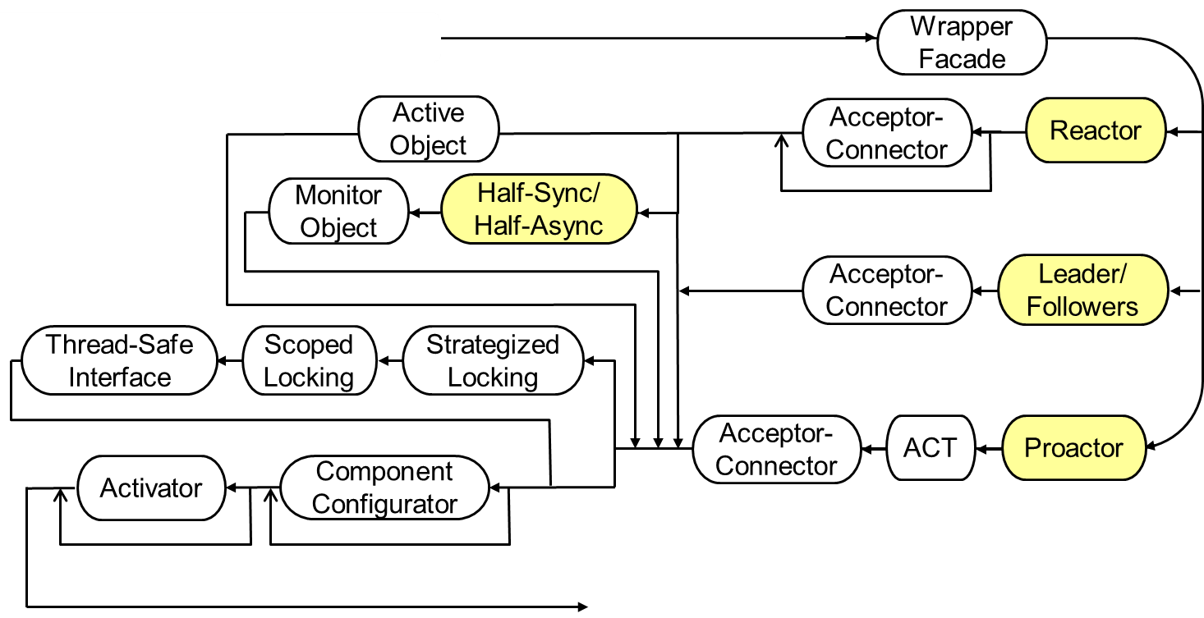
Topics Covered in this Part of the Module
Describe the Reactor & Acceptor-Connector patterns
Describe the ACE Reactor framework
Apply ACE Reactor framework to JAWS
Very simple path thru the JAWS pattern language

Slide 63
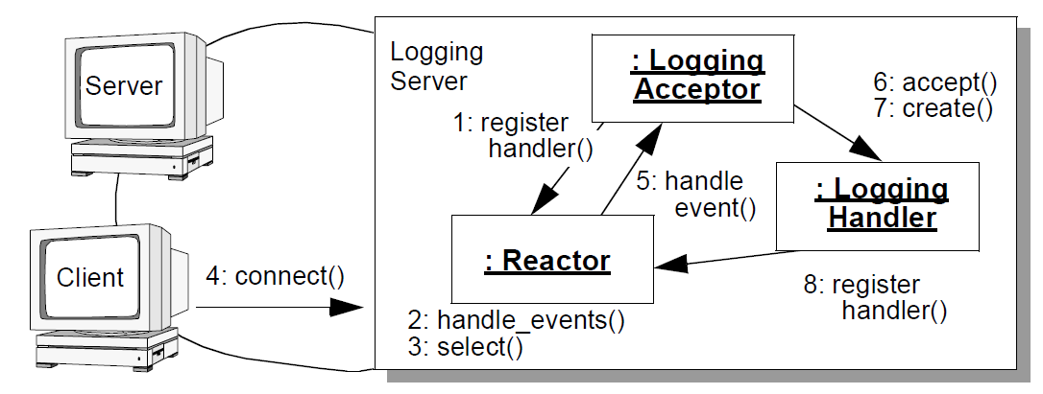


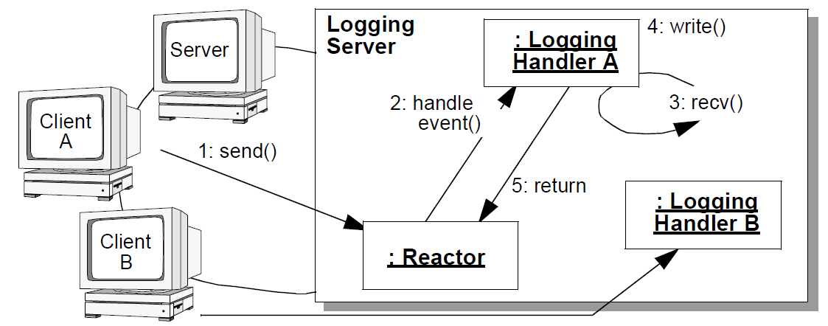
ACE Reactor Implementation of JAWS
Connection establishment & service initialization phase
Web Server
: HTTP_Event _Acceptor
5: handle input()
: HTTP_Event _Handler
: ACE_ Reactor
2: run_event_loop() 3: select()
Web Server
: HTTP_Event _Handler A
4: reply
: HTTP_ Handler A
2: handle input()
Data transfer phase
1: GET
: HTTP_Event _Handler B
: HTTP_ Handler B
ACE_ Reactor

Slide 64
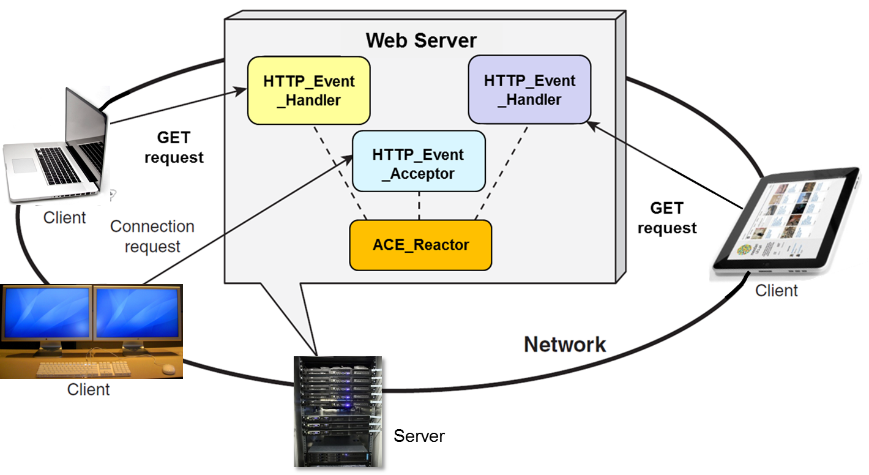
Using the ACE_Event_Handler Class with JAWS
We implement a reactive JAWS web server by inheriting from ACE_Event_Handler & driving its processing via the reactor’s event loop to handle two types of events:
Accept events that indicate new client connection requests
Data events that indicate GET requests from connected clients

Slide 65
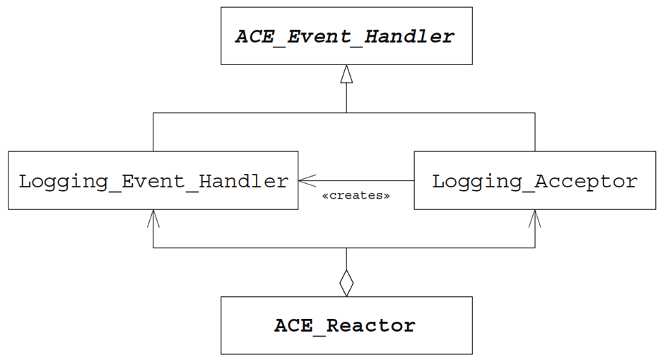
Using ACE_Event_Handler with JAWS
We define two types of event handlers in our reactive web server:
HTTP_Event_Acceptor
Factory that allocates HTTP_Event_Handler dynamically & initializes it when client connects
Uses ACE_SOCK_Acceptor to initialize ACE_SOCK_Stream contained in HTTP_Event _Handler
HTTP_Event_Handler
Processes GET requests received from connected clients
Uses ACE_SOCK_Stream to read GET request from a connection
HTTP_Event_ Acceptor
HTTP_Event_Handler

Slide 66
Using ACE_Event_Handler with JAWS
The HTTP_Event_Acceptor is a factory that allocates an HTTP_Event_ Handler dynamically & initializes it when a client connects to the web server
class HTTP_Event_Acceptor : public ACE_Event_Handler {
private:
ACE_SOCK_Acceptor acceptor_;
public:
HTTP_Event_Acceptor (ACE_Reactor *r = ACE_Reactor::instance())
: ACE_Event_Handler (r) {}
virtual int open (const ACE_INET_Addr &local_addr) {
acceptor_.open (local_addr);
return reactor ()->register_handler
(this, ACE_Event_Handler::ACCEPT_MASK);
}
Factory that passively connects ACE_SOCK_Streams
Note default use of reactor singleton
Initialization forwards to ACE_SOCK_Acceptor
Register this object with the reactor for accept events
Some error checking has been omitted to reduce clutter

Slide 67
Using ACE_Event_Handler with JAWS
Hook method called when object removed from reactor
virtual int handle_close (ACE_HANDLE, ACE_Reactor_Mask) {
acceptor_.close ();
delete this;
return 0;
}
virtual ACE_HANDLE get_handle () const
{ return acceptor_.get_handle (); }
virtual int handle_input (ACE_HANDLE);
};
It’s ok to “delete this” when the event handler is destroyed!
Return passive-mode socket's I/O handle
Key hook method dispatched by reactor when there’s a new connection to accept (implementation shown shortly)

Slide 68
Using ACE_Event_Handler with JAWS
The HTTP_Event_Handler processes GET request from connected client
class HTTP_Event_Handler : public ACE_Event_Handler {
protected:
ACE_SOCK_Stream stream_;
public:
HTTP_Event_Handler (ACE_Reactor *r): ACE_Event_Handler (r) {}
virtual int open ();
ACE_SOCK_Stream &peer () { return stream_; };
virtual int handle_input (ACE_HANDLE);
virtual int handle_close (ACE_HANDLE, ACE_Reactor_Mask);
};
Connection to remote peer
Activation hook method
Get reference to contained ACE_SOCK_Stream
Key hook method dispatched by reactor when GET requests arrive
Called by a reactor when handler is closing

Slide 69
Using ACE_Event_Handler with JAWS
Factory method called back by reactor when a connection event occurs
1 int HTTP_Event_Acceptor::handle_input (ACE_HANDLE) {
2 HTTP_Event_Handler *peer_handler = new (peer_handler,
3 HTTP_Event_Handler (reactor ()));
4 acceptor_.accept (peer_handler->peer ());
...
5 peer_handler->open ();
...
Create event handler to receive GET requests
Accept connection & store in ACE_SOCK_STREAM
Activate connected HTTP_Event_Handler

Slide 70
Using ACE_Event_Handler with JAWS
1 int HTTP_Event_Acceptor::handle_input (ACE_HANDLE) {
2 HTTP_Event_Handler *peer_handler = new (peer_handler,
3 HTTP_Event_Handler (reactor ()));
4 acceptor_.accept (peer_handler->peer ());
...
5 peer_handler->open ();
...
int HTTP_Event_Handler::open () {
return reactor ()->register_handler
(this, ACE_Event_Handler::READ_MASK);
}
Register with the reactor to receive input events containing GET requests

Slide 71
Using ACE_Event_Handler with JAWS
Called back by the reactor when a data event occurs
int HTTP_Event_Handler::handle_input (ACE_HANDLE) {
std::string pathname (get_pathname (stream_));
ACE_Mem_Map mapped_file (pathname.c_str ());
if (peer ().send_n (mapped_file.addr (),
mapped_file.size ()) == -1) return -1;
peer ().close ();
return 0;
}
int HTTP_Event_Handler::handle_close (ACE_HANDLE,
ACE_Reactor_Mask) { stream_.close ();
delete this;
return 0;
}
Memory map the requested content
Transmits content back to client
Called back by the reactor when handle_input() returns -1
Note similarity of handle_input() logic wrt earlier Wrapper Façade solution

Slide 72
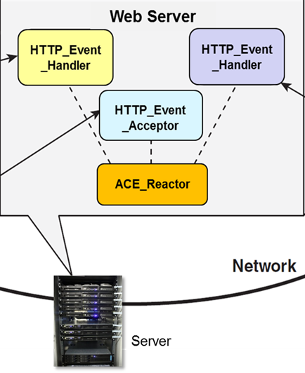
Using ACE_Reactor with JAWS
This example illustrates a web server that
Runs in a single thread of control in a single process

Slide 73
Using ACE_Reactor with JAWS
This example illustrates a web server that
Runs in a single thread of control in a single process
Handles connection & GET requests from multiple clients reactively

Slide 74
Using ACE_Reactor with JAWS
This example illustrates a web server that
Runs in a single thread of control in a single process
Handles connection & GET requests from multiple clients reactively
Template parameter is used as base class
template <typename ACCEPTOR>
class Reactor_HTTP_Server : public ACCEPTOR {
public:
Reactor_HTTP_Server (int argc, char *argv[], ACE_Reactor *);
};

Slide 75
Using ACE_Reactor with JAWS
1 template <typename ACCEPTOR>
2 Reactor_HTTP_Server<ACCEPTOR>::Reactor_HTTP_Server
3 (int argc, char *argv[], ACE_Reactor *reactor)
4 : ACCEPTOR (reactor) {
5 u_short HTTP_port = argc > 1 ? atoi (argv[1]) : 80;
6 typename ACCEPTOR::PEER_ADDR server_addr (HTTP_port, INADDR_ANY);
7 if (ACCEPTOR::open (addr) == -1)
8 reactor->end_reactor_event_loop ();
9 }
Initialize ACCEPTOR base class with reactor pointer
Begin listening for connections
Socket address to listen on for connections
Shutdown reactor’s event loop if an error occurs

Slide 76
Using ACE_Reactor with JAWS
1 typedef Reactor_HTTP_Server<HTTP_Event_Acceptor>
2 HTTP_Server_Daemon;
3 int main (int argc, char *argv[]) {
4 ACE_Reactor reactor;
5 new HTTP_Server_Daemon (argc, argv, &reactor);
6
7 reactor.run_reactor_event_loop ()
...
Instantiate template with HTTP_Event_Acceptor
Event loop controller object
Dynamic allocation ensures proper deletion semantics
Run web server event loop
This reactive event loop structure can be further generalized, as we’ll see later

Slide 77
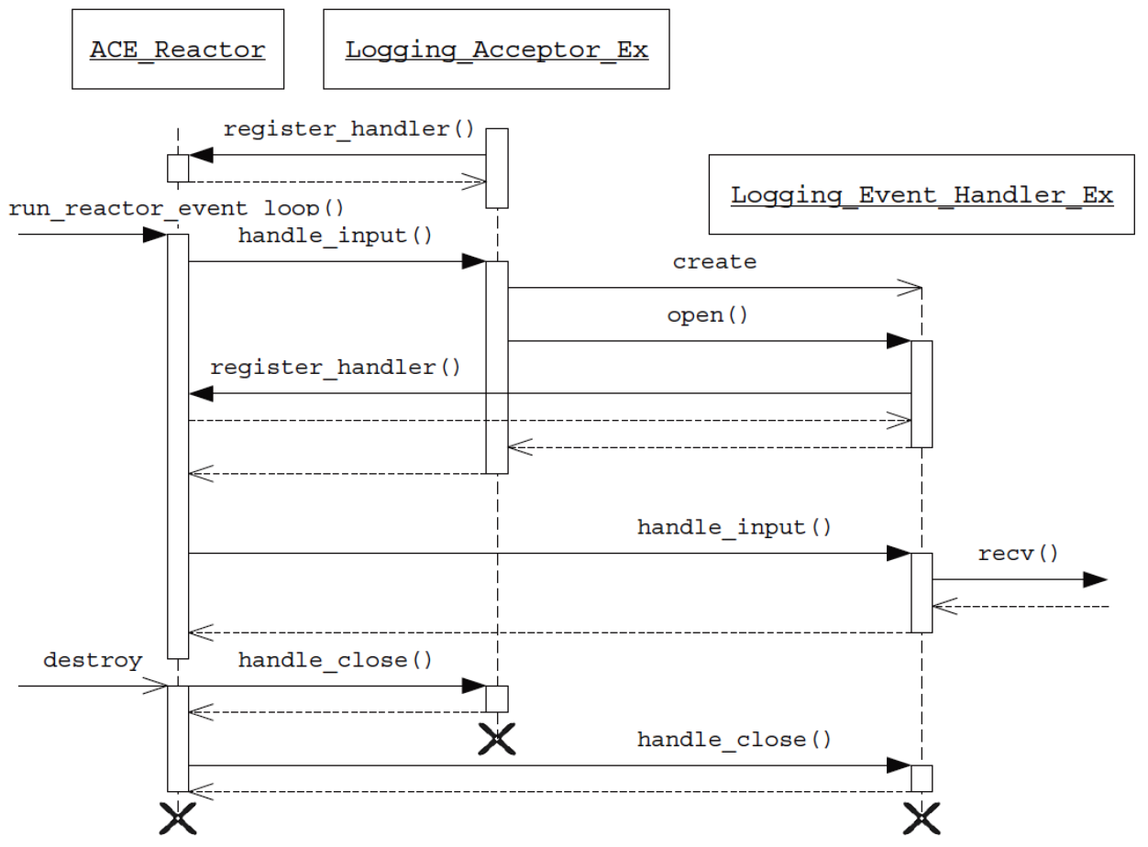
Using ACE_Reactor with JAWS
HTTP_Event_Acceptor
Register interest in receiving connection notifications
HTTP_Event_Handler
Sequence diagram for ACE Reactor-based web server

Slide 78
Using ACE_Reactor with JAWS
HTTP_Event_Acceptor
HTTP_Event_Handler
When a connection arrives create an event handler
Sequence diagram for ACE Reactor-based web server

Slide 79
Using ACE_Reactor with JAWS
HTTP_Event_Acceptor
HTTP_Event_Handler
Register interest in receiving data notifications
Sequence diagram for ACE Reactor-based web server

Slide 80
Using ACE_Reactor with JAWS
HTTP_Event_Acceptor
HTTP_Event_Handler
When data arrives process it using HTTP
Sequence diagram for ACE Reactor-based web server

Slide 81
Using ACE_Reactor with JAWS
HTTP_Event_Acceptor
HTTP_Event_Handler
We’ll shortly refactor these steps using the Template Method pattern to form part of the Acceptor-Connector pattern
Sequence diagram for ACE Reactor-based web server

Slide 82
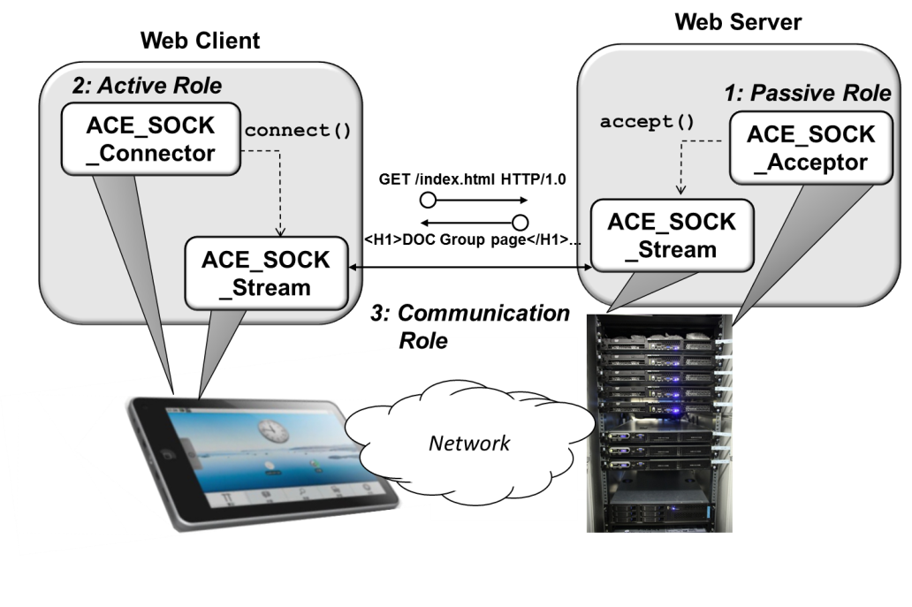
Summary
The ACE Reactor version of JAWS is more modular & flexible than the Wrapper Façade version we described earlier
Wrapper facades resolve accidental complexities with system APIs, but don’t address architectural concerns

Slide 83
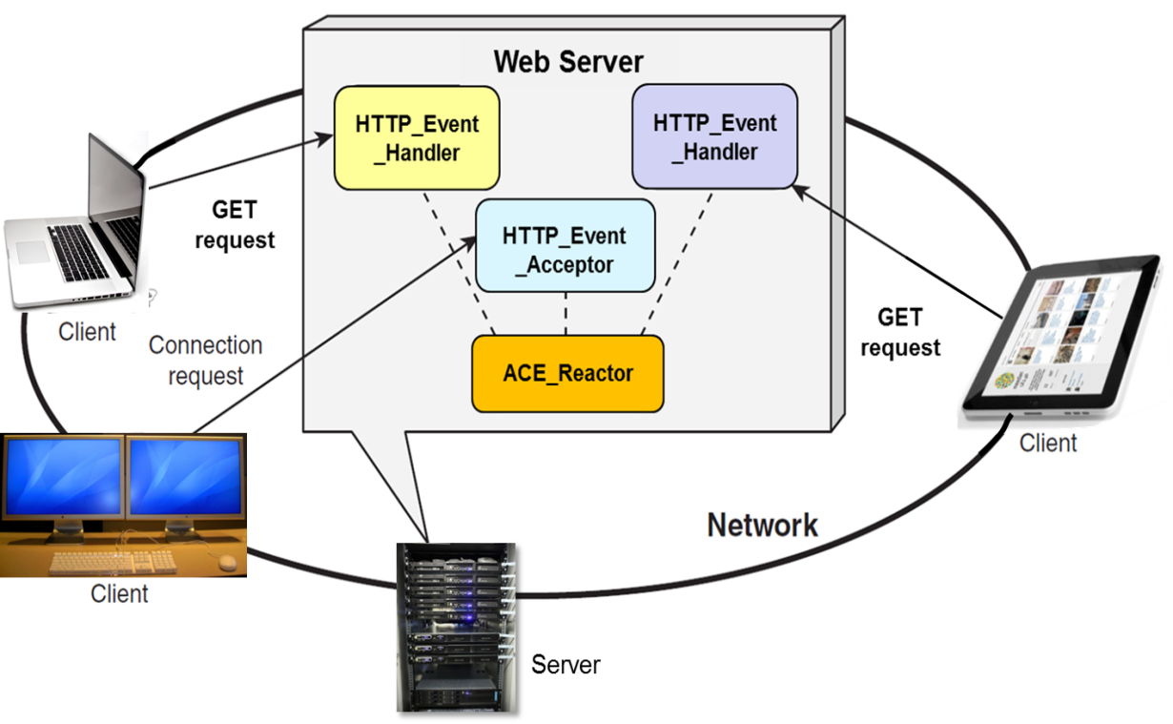
Summary
The ACE Reactor version of JAWS is more modular & flexible than the Wrapper Façade version we described earlier
Wrapper facades resolve accidental complexities with system APIs, but don’t address architectural concerns
The Reactor framework provides the architecture for the JAWS reactive web server version
It’s core processing logic is similar
The context in which this logic is based, however, can be adapted & extended much more readily

Slide 84
Patterns & Frameworks for Synchronous Event Handling, Connections, & Service Initialization: Part 4
Douglas C. Schmidt
d.schmidt@vanderbilt.edu
www.dre.vanderbilt.edu/~schmidt
Professor of Computer Science
Institute for Software Integrated Systems Vanderbilt University Nashville, Tennessee, USA

Slide 85
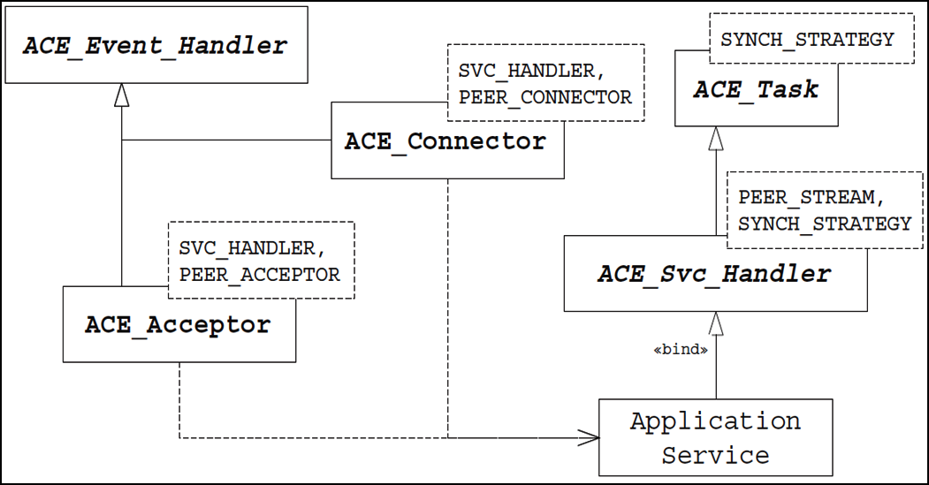
Topics Covered in this Part of the Module
Describe the Reactor & Acceptor- Connector patterns
Describe the ACE Reactor framework
Apply ACE Reactor to JAWS
Describe ACE Acceptor-Connector framework & apply it to JAWS

Slide 86
Topics Covered in this Part of the Module
Describe the Reactor & Acceptor- Connector patterns
Describe the ACE Reactor framework
Apply ACE Reactor to JAWS
Describe ACE Acceptor-Connector framework & apply it to JAWS
Another path thru JAWS pattern language

Slide 87
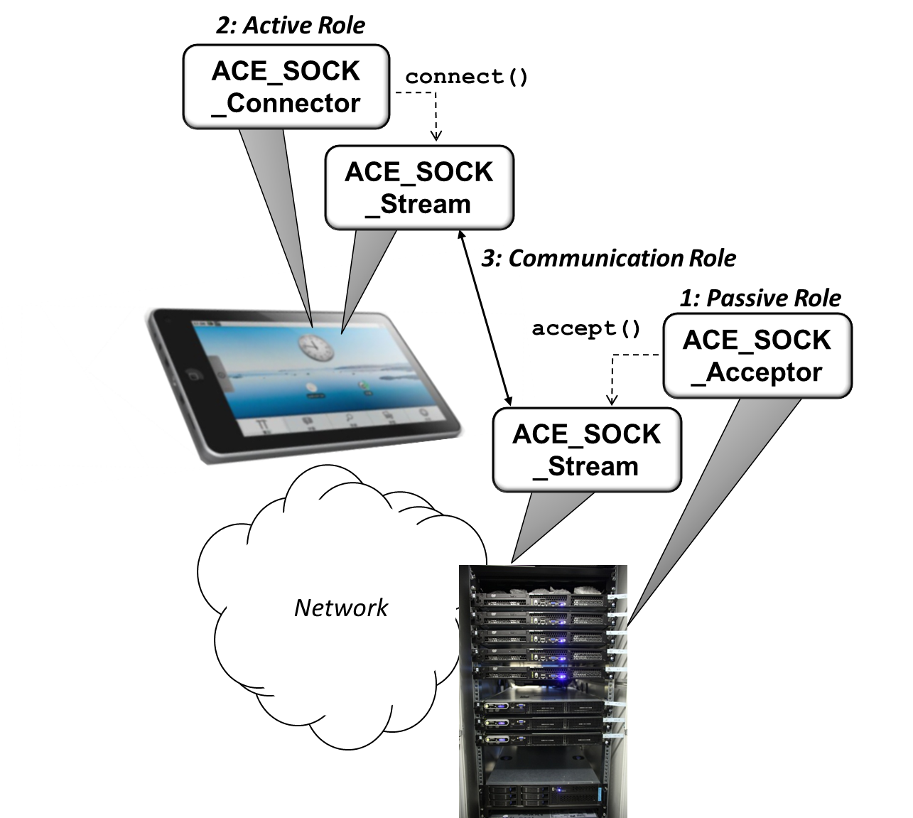
Motivation for ACE Acceptor-Connector Framework
Connection-oriented networked apps often play stylized roles:
Connection role determines how an app establishes connections
Connection Role
Connection Role

Slide 88
Motivation for ACE Acceptor-Connector Framework
Connection-oriented networked apps often play stylized roles:
Connection role determines how an app establishes connections
Communication role determines whether an app plays the role of a client, a server, or both
Connection Role
Communication Role
Connection Role

Slide 89
Motivation for ACE Acceptor-Connector Framework
Connection-oriented networked apps often play stylized roles:
Connection role determines how an app establishes connections
Communication role determines whether an app plays the role of a client, a server, or both
Connection-oriented networked apps typified by asymmetric connection roles:
Servers often passively accept connections at a listening port

Slide 90
Motivation for ACE Acceptor-Connector Framework
Connection-oriented networked apps often play stylized roles:
Connection role determines how an app establishes connections
Communication role determines whether an app plays the role of a client, a server, or both
Connection-oriented networked apps typified by asymmetric connection roles:
Servers often passively accept connections at a listening port
Clients often actively initiate connections by connecting to a server’s listening port
Factoring out these roles into a framework can enhance reuse & robustness

Slide 91
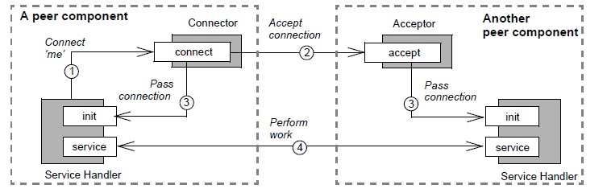
Overview of ACE Acceptor-Connector Framework
The classes in this framework decouple connection & initialization of cooperating peer services in a networked app from processing they perform after being connected & initialized
connect
accept

Slide 92
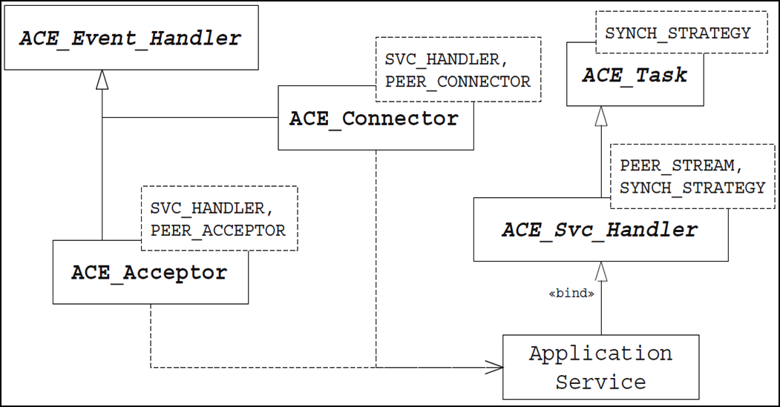
Overview of ACE Acceptor-Connector Framework
The classes in this framework decouple connection & initialization of cooperating peer services in a networked app from processing they perform after being connected & initialized
Apps subclass from ACE_Svc_Handler & override its hook methods to process events via various activation models
e.g., reactive & multi-threading/ multi-processing
Classes are designed in accordance with the Acceptor-Connector pattern

Slide 93
Overview of ACE Acceptor-Connector Framework
The classes in this framework decouple connection & initialization of cooperating peer services in a networked app from processing they perform after being connected & initialized
Apps subclass from ACE_Svc_Handler & override its hook methods to process events via various activation models
Key classes in the ACE Acceptor-Connector framework include:
ACE Class | Description
ACE_Svc_Handler | Represents the local end of a connected service & contains an IPC endpoint used to communicate with a connected peer
ACE_Acceptor | This factory waits passively to accept a connection and then initializes an ACE Svc Handler in response to an active connection request from a peer
ACE_Connector | This factory actively connects to a peer acceptor and then initializes an ACE_Svc_Handler to communicate with its connected peer

Slide 94
Overview of ACE Acceptor-Connector Framework
The classes in this framework decouple connection & initialization of cooperating peer services in a networked app from processing they perform after being connected & initialized
Apps subclass from ACE_Svc_Handler & override its hook methods to process events via various activation models
Key classes in the ACE Acceptor-Connector framework include:
ACE Class | Description
ACE_Svc_Handler | Represents the local end of a connected service & contains an IPC endpoint used to communicate with a connected peer
ACE_Acceptor | This factory waits passively to accept a connection and then initializes an ACE Svc Handler in response to an active connection request from a peer
ACE_Connector | This factory actively connects to a peer acceptor and then initializes an ACE_Svc_Handler to communicate with its connected peer

Slide 95
Overview of ACE Acceptor-Connector Framework
The classes in this framework decouple connection & initialization of cooperating peer services in a networked app from processing they perform after being connected & initialized
Apps subclass from ACE_Svc_Handler & override its hook methods to process events via various activation models
Key classes in the ACE Acceptor-Connector framework include:
ACE Class | Description
ACE_Svc_Handler | Represents the local end of a connected service & contains an IPC endpoint used to communicate with a connected peer
ACE_Acceptor | This factory waits passively to accept a connection and then initializes an ACE Svc Handler in response to an active connection request from a peer
ACE_Connector | This factory actively connects to a peer acceptor and then initializes an ACE_Svc_Handler to communicate with its connected peer
See www.dre.vanderbilt.edu/~schmidt/PDF/Acc-Con.pdf for more info

Slide 96
The ACE_Svc_Handler Class
This class provides synchronous & reactive data transfer capabilities:
SYNCH_STRATEGY
ACE_Task
PEER_STREAM
PEER_STREAM
SYNCH_STRATEGY
ACE_Svc_Handler
peer() : PEER_STREAM &
destroy()
shutdown()
…

Slide 97
The ACE_Svc_Handler Class
This class provides synchronous & reactive data transfer capabilities:
It provides an IPC endpoint used to communicate with its peer service handler
SYNCH_STRATEGY
ACE_Task
PEER_STREAM
PEER_STREAM
SYNCH_STRATEGY
ACE_Svc_Handler
peer() : PEER_STREAM &
destroy()
shutdown()
…

Slide 98
The ACE_Svc_Handler Class
This class provides synchronous & reactive data transfer capabilities:
It provides an IPC endpoint used to communicate with its peer service handler
It codifies common practices of reactive network services
e.g., registering with a reactor when service is opened & closing IPC endpoint when unregistering a service from a reactor
SYNCH_STRATEGY
ACE_Task
PEER_STREAM
PEER_STREAM
SYNCH_STRATEGY
ACE_Svc_Handler
peer() : PEER_STREAM &
destroy()
shutdown()
…

Slide 99
The ACE_Svc_Handler Class
This class provides synchronous & reactive data transfer capabilities:
It provides an IPC endpoint used to communicate with its peer service handler
It codifies common practices of reactive network services
e.g., registering with a reactor when service is opened & closing IPC endpoint when unregistering a service from a reactor
It can also participate in other concurrency models
e.g., active object, etc.
SYNCH_STRATEGY
ACE_Task
PEER_STREAM
PEER_STREAM
SYNCH_STRATEGY
ACE_Svc_Handler
peer() : PEER_STREAM &
destroy()
shutdown()
…
ACE_Svc_Handler inherits ACE concurrency, queueing, synchronization, dynamic configuration, & event handling framework capabilities from its base classes
Handles variability of IPC & synchronization via a common network I/O API

Slide 100
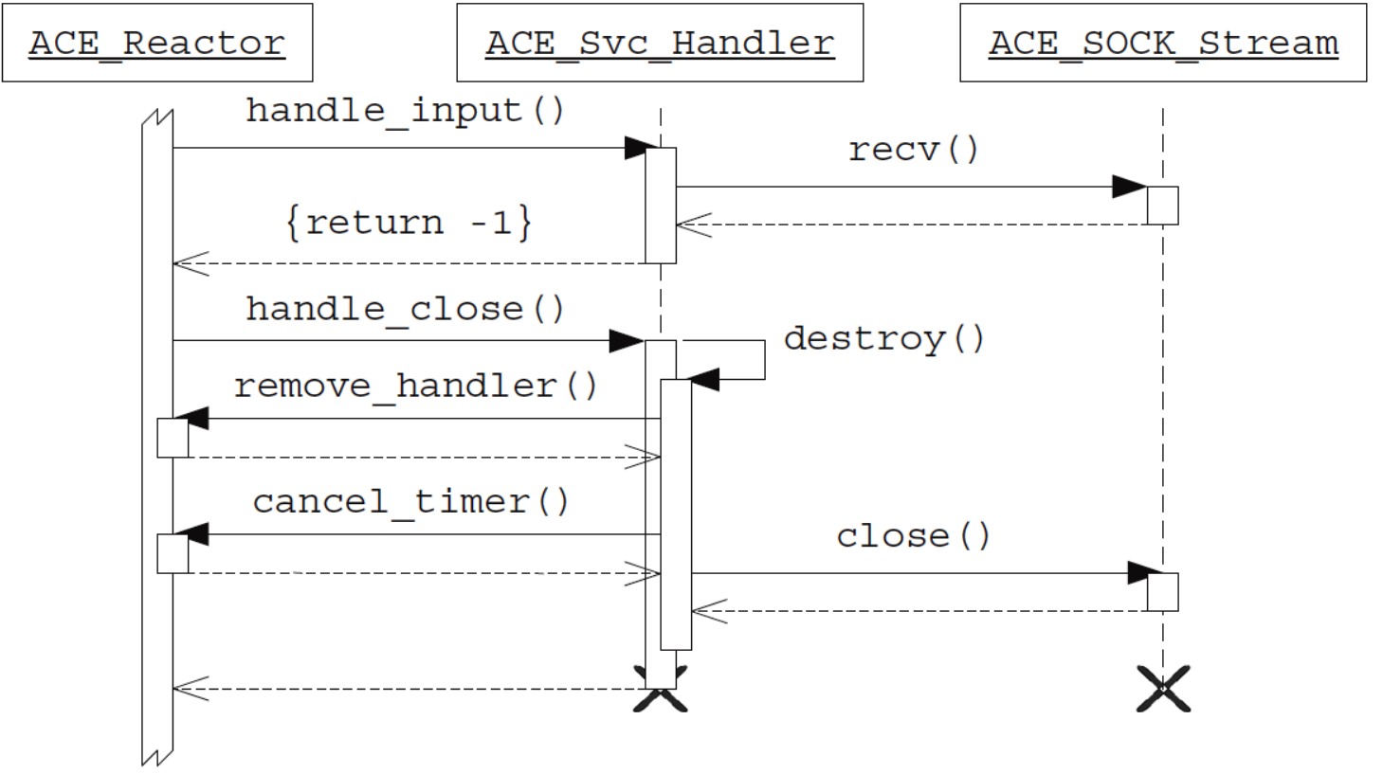
Combining ACE_Svc_Handler with ACE_Reactor
An ACE_Svc_Handler can be registered with the ACE Reactor framework for READ events
The Reactor framework then dispatches ACE_Svc_Handler:: handle_input() to receive the data when input arrives on a connection

Slide 101
Combining ACE_Svc_Handler with ACE_Reactor
The Reactor framework can also trigger orderly destruction of an ACE_Svc_Handler

Slide 102
The ACE_Acceptor Class
This class is a factory playing the Acceptor role in Acceptor-Connector pattern:
It decouples passive connection establishment & service initialization logic from subsequent processing performed by a service handler
ACE_Service_Object
PEER_ACCEPTOR
SVC_HANDLER
PEER_ACCEPTOR
ACE_Acceptor
+ open()
+ close()
+ acceptor()
# make_svc_handler()
# accept_svc_handler()
# activate_svc_handler()
…

Slide 103
The ACE_Acceptor Class
This class is a factory playing the Acceptor role in Acceptor-Connector pattern:
It decouples passive connection establishment & service initialization logic from subsequent processing performed by a service handler
It provides a parameterized passive- mode IPC endpoint that listens for & accepts connections from peers
ACE_Service_Object
PEER_ACCEPTOR
SVC_HANDLER
PEER_ACCEPTOR
ACE_Acceptor
+ open()
+ close()
+ acceptor()
# make_svc_handler()
# accept_svc_handler()
# activate_svc_handler()
…

Slide 104
The ACE_Acceptor Class
This class is a factory playing the Acceptor role in Acceptor-Connector pattern:
It decouples passive connection establishment & service initialization logic from subsequent processing performed by a service handler
It provides a parameterized passive- mode IPC endpoint that listens for & accepts connections from peers
It automates the steps necessary to connect the IPC endpoint passively & create/activate its associated service handler
ACE_Service_Object
PEER_ACCEPTOR
SVC_HANDLER
PEER_ACCEPTOR
ACE_Acceptor
+ open()
+ close()
+ acceptor()
# make_svc_handler()
# accept_svc_handler()
# activate_svc_handler()
…

Slide 105
The ACE_Acceptor Class
This class is a factory playing the Acceptor role in Acceptor-Connector pattern:
It decouples passive connection establishment & service initialization logic from subsequent processing performed by a service handler
It provides a parameterized passive- mode IPC endpoint that listens for & accepts connections from peers
It automates the steps necessary to connect the IPC endpoint passively & create/activate its associated service handler
ACE_Service_Object
PEER_ACCEPTOR
SVC_HANDLER
PEER_ACCEPTOR
ACE_Acceptor
+ open()
+ close()
+ acceptor()
# make_svc_handler()
# accept_svc_handler()
# activate_svc_handler()
…
ACE_Acceptor inherits ACE dynamic configuration & event handling framework capabilities from its base classes
Handles IPC & service handler variability via common connect/initialize API

Slide 106
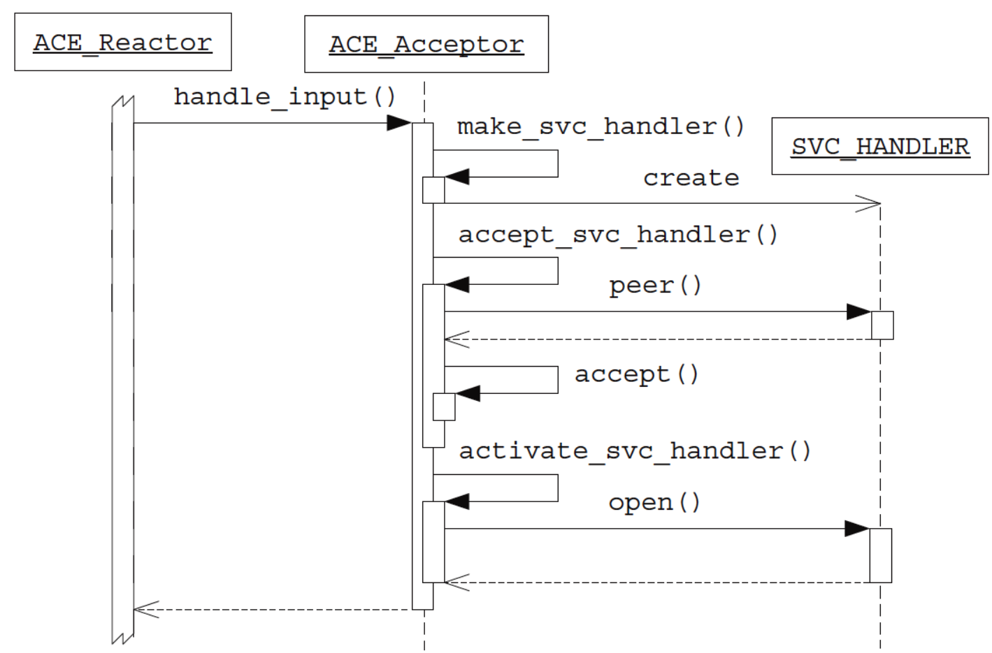
Combining ACE_Acceptor with ACE_Reactor
An instance of ACE_ Acceptor can be registered with the ACE Reactor framework to handle ACCEPT events

Slide 107
Combining ACE_Acceptor with ACE_Reactor
The Reactor framework will dispatch ACE_Acceptor ::handle_input() when a new connection arrives

Slide 108
Combining ACE_Acceptor with ACE_Reactor
Note how handle_input() implements the GoF Template Method pattern!

Slide 109
ACE Acceptor-Connector Implementation of JAWS
Connection establishment & service initialization phase
Web Server
: HTTP_Svc _Acceptor
5: handle input()
: HTTP_Svc _Handler
: ACE_ Reactor
2: run_event_loop() 3: select()
Web Server
: HTTP_Svc _Handler A
4: reply
: HTTP_ Handler A
2: handle input()
Data transfer phase
1: GET
: HTTP_Svc _Handler B
: HTTP_ Handler B
ACE_ Reactor

Slide 110
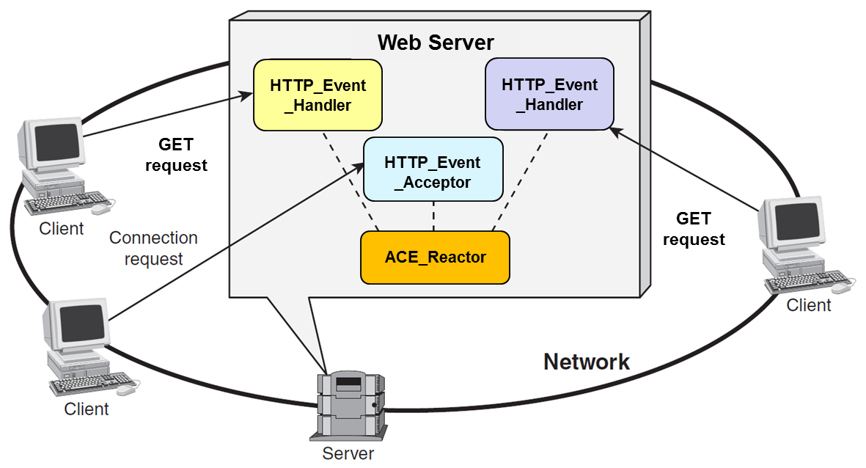

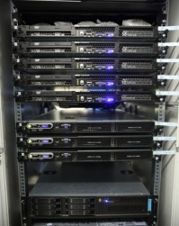
Reactive Event Handling with ACE_Acceptor
This example shows how to use ACE_Acceptor & ACE_Svc_Handler to implement a reactive web server
HTTP_Svc _Handler
HTTP_Svc _Handler
Logging
Event
Handler
HTTP_Event_ Handler
HTTP_Svc _Acceptor
Server
There’s very little app code since the ACE frameworks do much of the work!

Slide 111
Reactive Event Handling with ACE_Svc_Handler
class HTTP_Svc_Handler
: public ACE_Svc_Handler<ACE_SOCK_Stream, ACE_NULL_SYNCH> {
public:
...
virtual int handle_input(ACE_HANDLE) {
std::string pathname (get_pathname (peer ()));
ACE_Mem_Map mapped_file (pathname.c_str ());
return peer.send_n (mapped_file.addr (),
mapped_file.size ());
}
...
Be a service handler that uses ACE_SOCK_Stream to communicate with clients
Called back by reactor when a GET request arrives
Extract path from GET request
Memory map the requested content
Transmits content back to client
This “business logic” is the main piece of code you need to write!

Slide 112
Reactive Event Handling with ACE_Acceptor
Instantiate ACE_Acceptor
1 typedef ACE_Acceptor<HTTP_Svc_Handler, ACE_SOCK_Acceptor>
2 HTTP_Svc_Acceptor;
3 typedef Reactor_HTTP_Server<HTTP_Svc_Acceptor>
4 HTTP_Server_Daemon;
5 int main (int argc, char *argv[]) {
6 ACE_Reactor reactor;
7 new HTTP_Server_Daemon (argc, argv, &reactor);
8
9 reactor.run_reactor_event_loop ();
...
10 }
Reuse our earlier template driver & Instantiate it with the HTTP_Svc_Acceptor
Event loop controller object
Dynamic allocation ensures proper deletion semantics
Run server event loop
Note the extensive design & code reuse here!

Slide 113
Summary
The ACE Acceptor-Connector framework decoupled JAWS’s connection establishing & service handler initialization from its HTTP protocol handling
This separation of concerns allows different parts of the software to independently evolve & promotes a highly modular & reusable design
ACE_Event _Handler
ACE_Reactor
*
handle_events()
register_handler()
remove_handler()
dispatches
handle_input()
get_handle()
*
owns
Handle
*
notifies
<<uses>>
handle set
Synchronous
Event Demuxer
ACE_ Acceptor
ACE_Svc
_Handler
handle_input()
get_handle()
handle_input()
get_handle()
select()
Generic & reusable framework
HTTP_Svc
_Acceptor
HTTP_Svc
_Handler
handle_input()
get_handle()
handle_input()
get_handle()
Specialized app code

Slide 114
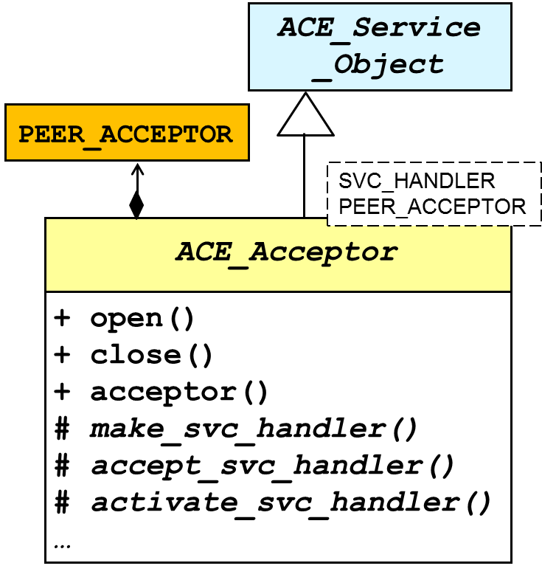
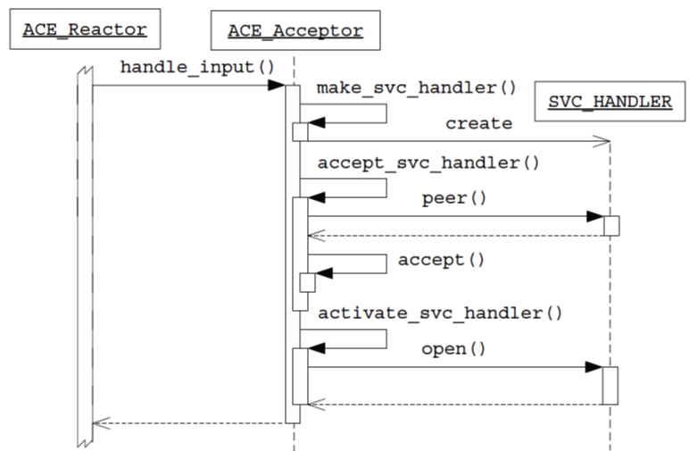
Summary
The ACE Acceptor-Connector framework decoupled JAWS’s connection establishing & service handler initialization from its HTTP protocol handling
This separation of concerns allows different parts of the software to independently evolve & promotes a highly modular & reusable design
Combining white-box & black-box reuse helps minimize code written by app developers
Connection establishment & service initialization code from reactive web server is gone!
At the heart of these framework designs is commonality & variability analysis

